Slide 1
IF ELSE Staatements

Slide 2
Logical conditions from mathematics
Less than: a < b
Less than or equal to: a <= b
Greater than: a > b
Greater than or equal to: a >= b
Equal to a == b
Not Equal to: a != b

Slide 3
Java has the following conditional statements:
Use if to specify a block of code to be executed, if a specified condition is true
Use else to specify a block of code to be executed, if the same condition is false
Use else if to specify a new condition to test, if the first condition is false.

Slide 4
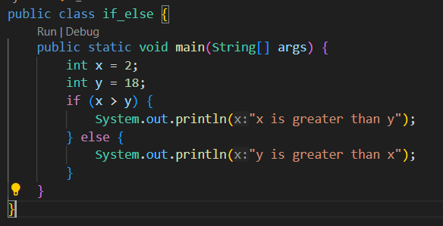

Slide 5
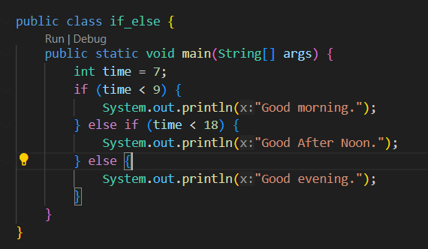

Slide 6
Python has the following conditional statements:
Use if to specify a block of code to be executed, if a specified condition is true
Use else to specify a block of code to be executed, if the same condition is false
Use elif to specify a new condition to test, if the first condition is false.

Slide 7
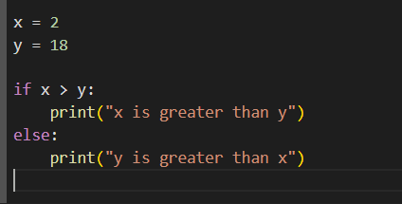

Slide 8
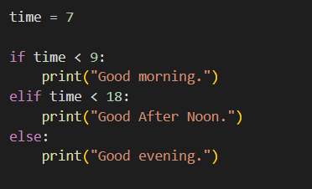

Slide 9
C++ has the following conditional statements:
Use if to specify a block of code to be executed, if a specified condition is true
Use else to specify a block of code to be executed, if the same condition is false
Use else if to specify a new condition to test, if the first condition is false.

Slide 10
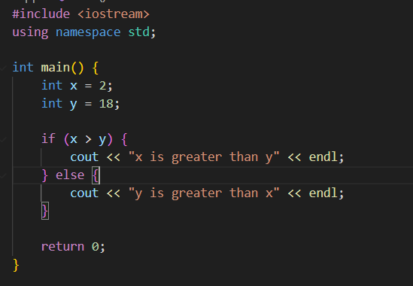

Slide 11
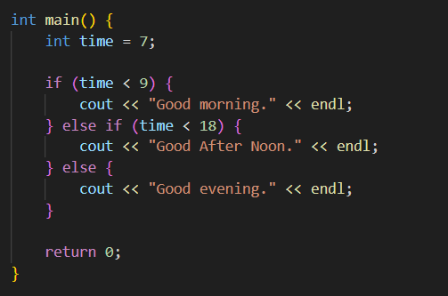

Slide 12
Task…….
Write a program that takes an integer as input from the user and prints whether it is positive, negative, or zero.
Write a program that takes two integers as input from the user and prints which one is greater.
Write a program that takes a character as input from the user and prints whether it is a vowel or a consonant.
Write a program that takes a number as input from the user and prints whether it is even or odd.
Write a program that takes a year as input from the user and prints whether it is a leap year or not.
Write a program that takes a percentage as input from the user and prints the grade as A, B, C, D, or F based on the following criteria:
A: 90-100%
B: 80-89%
C: 70-79%
D: 60-69%
F: Below 60%

